Slide 1


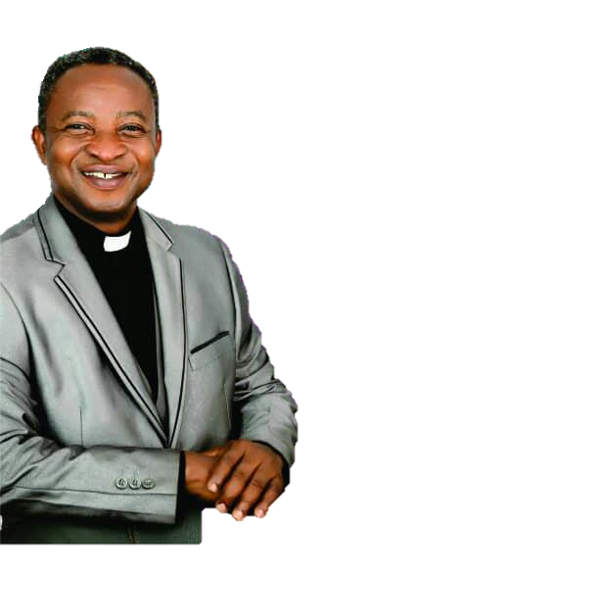
ALL NATIONS FOR CHRIST
CHURCH INTERNATIONAL
(The Church with a Global Apostolic Vision)
Presents a Mega
CRUSADE
THEME:
FOR THE SON OF MAN HAS COME TO SEEK AND SAVE THAT WHICH IS LOST
… Luke 19:10 …
28th March, 2020
Ada (Totemehkope)
6:00pm prompt
MAIN SPEAKER:
APOSTLE ROBERT KWADJO BOAMAH-ADJEI
INFO:
0208176141/0549762196

